Slide 1
Loan Defaulter Segmentation
SHIVAM MISHRA

Slide 2
AGENDA
Introduction​
Analysis
Univariate Numeric Variable Analysis
Bivariate Numeric Variable Analysis
Analysis On Merged Data
​​Conclusion
Precautions

Slide 3
Introduction
Defaulting on a loan happens when you miss payments for a specified period of time. When a loan defaults, it’s sent to a debt collection agency whose job is to collect the unpaid funds from you.
Example –
Student Loans
Credit Cards
Mortgages
Auto Loans
Other Types of Loans

Slide 4
analysis
On the basis of charts

Slide 5
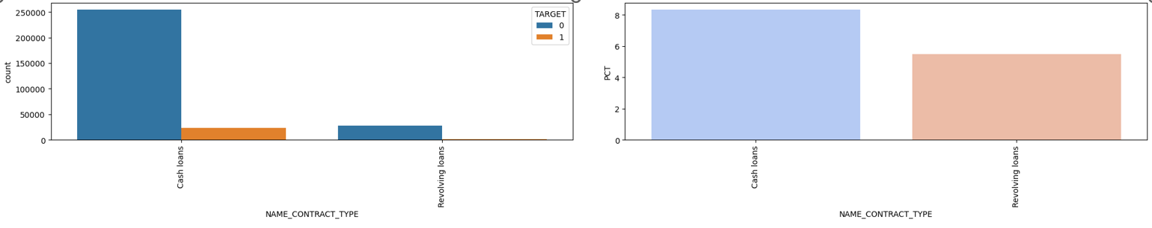
Name contract type
Most of the customers have taken cash loan
Customers who have taken cash loans are less likely to default

Slide 6
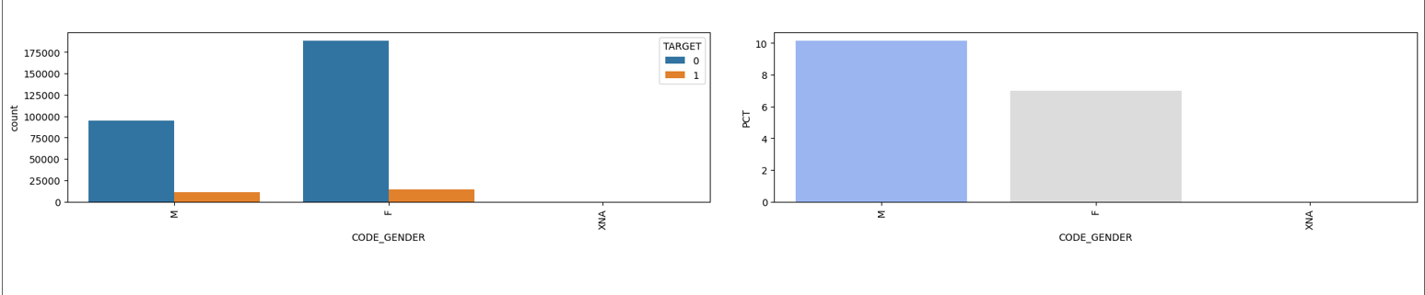
Code gender
Most of the loans are taken by Females
Default rate for females are just ~7% which is safer and lesser than male

Slide 7
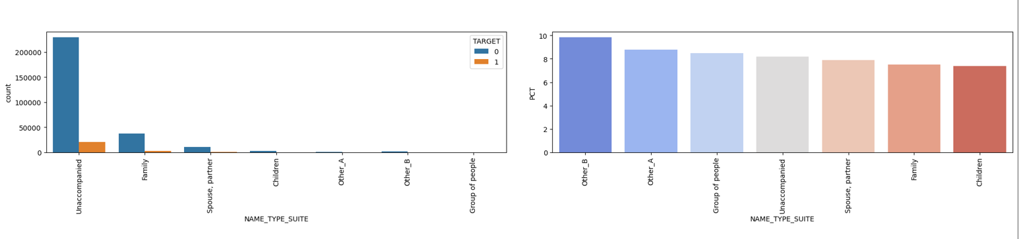
Name type suit
Unaccompanied people had take most of the loans and the default rate is ~8.5% which is still okay

Slide 8
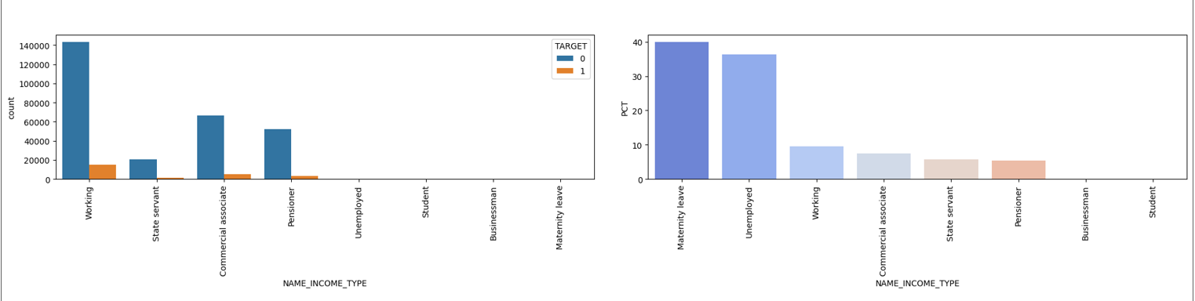
Name income type
The safest segments are working, commercial associates and pensioners

Slide 9
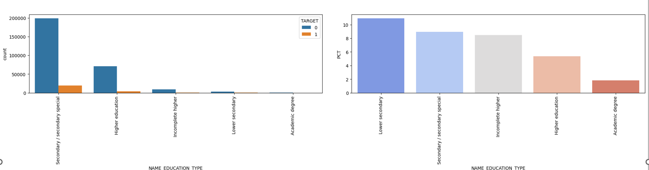
Name education type
Higher education is the safest segment to give the loan with a default rate of less than 5%

Slide 10
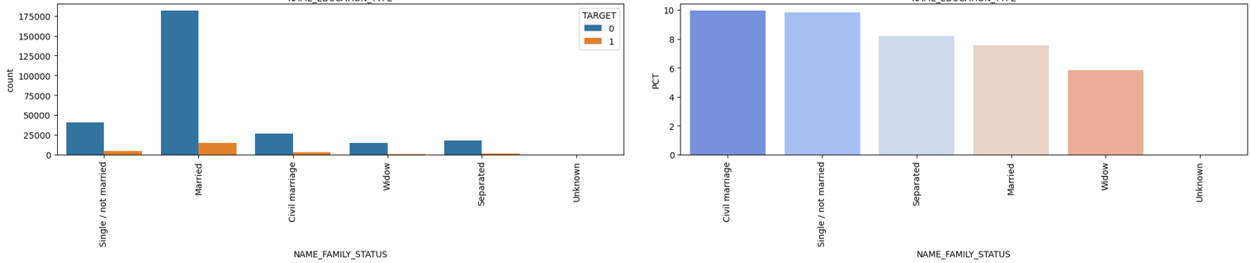
Name family status
Married people are safe to targe, default rate is 8%

Slide 11
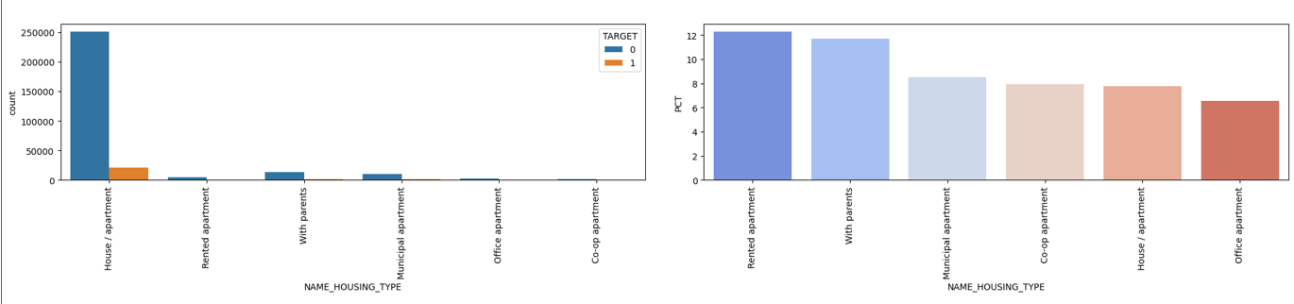
Name housing type
People having house/apartment are safe to give the loan with default rate of ~8%

Slide 12
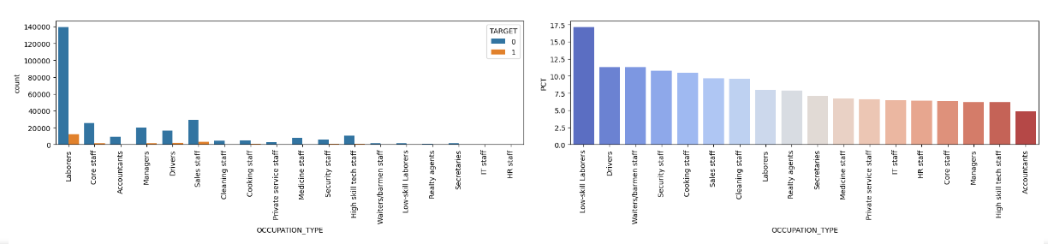
Occupation type
Low- Skill Laborers and drivers are highest defaulters
Accountants are less defaulters
Core staff, Managers and Laborers are safer to target with a defaulter rate of <=7.5% to 10%

Slide 13
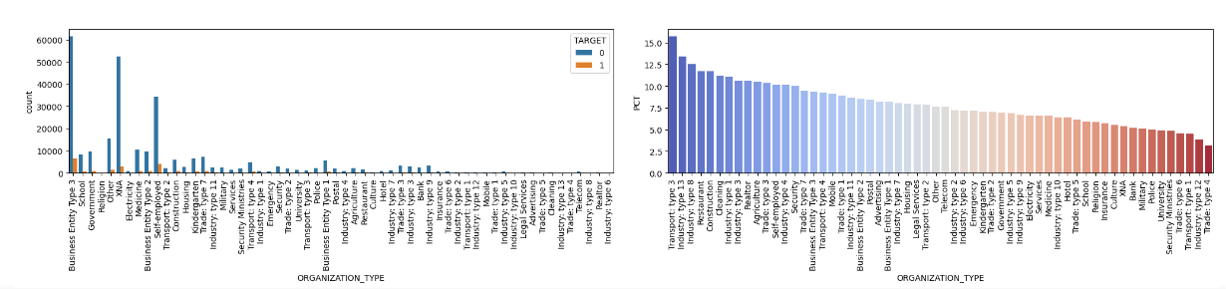
Organization type
Transport type 3 highest defaulter
Others, Business Entity Type 3, Self Employed are good to go with default rate around 10%

Slide 14
Univariate Numeric Variable Analysis

Slide 15
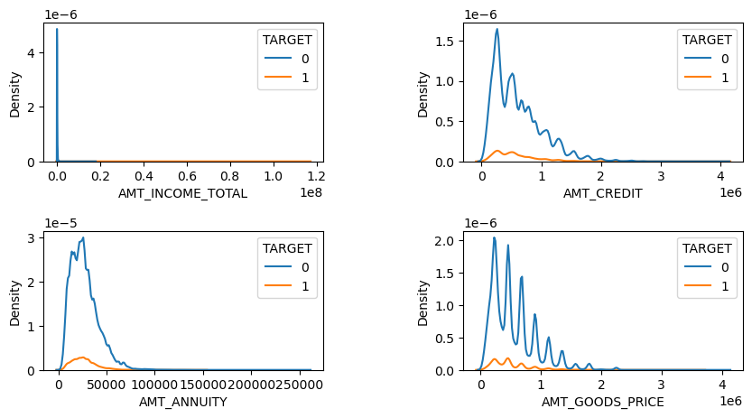
Most of the loans were given for the goods price ranging between 0 to 1 million
Most of the loans were given for the credit amount of 0 to 1 million
Most of the customers are paying annuity of 0 to 50K
Mostly the customers have income between 0 to 1 million

Slide 16
bivariate Numeric Variable Analysis

Slide 17
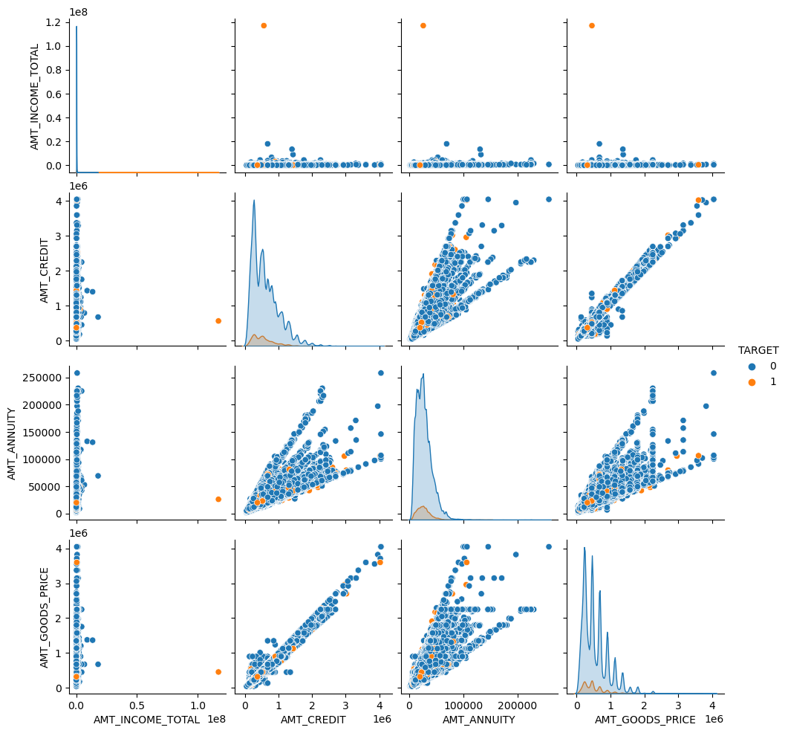
AMT_CREDIT and AMT_GOODS_PRICE are linearly corelated, if the AMT_CREDIT increases the defaulters are decreasing.
People having income less than or equals to 1 million, are more like to take loans out of which who are taking loans less than 1.5 million, could turn out to be defaulters
People having children 1 to less than 5 are safer to give the loan
People who can pay the annuity of 100k are more like to get the loan and that’s upto less than 2 million(safer segment)

Slide 18
Analysis On Merged Data

Slide 19
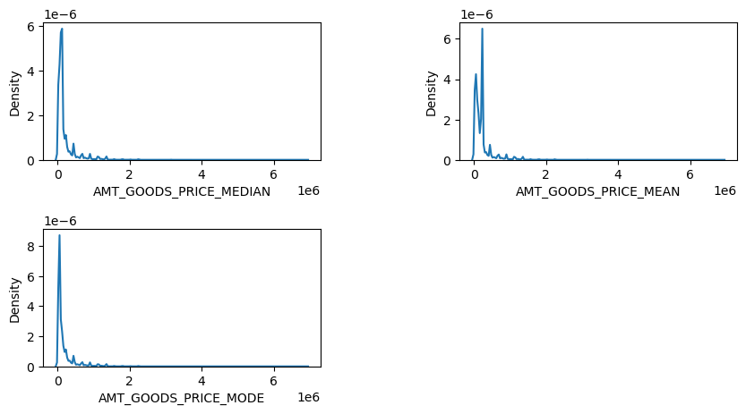
For the repairing purpose customers had applied mostly previous and the same purpose has most number of cancelations.
Most of the applications which were previous either cancelled or refused 80% - 90% of them are repaired in the current data
Others which were unused prev. now have max number of defaulters despite of having high income band customers

Slide 20
conclusion

Slide 21
Bank should target the customers –
Having low income i.e. below 1 million
Working in Others, Business Entity Type 3, Self Employed org. type
Working as Accountants, Core Staff, Managers and Laborers
Having house/apt and are married and having children not more than 5
Highly educated
Preferably female
Unaccompanied people can be safer – default rate is ~8.5%
Amount segment recommended –
The credit amount should not be more than 1 million
Annuity can be made of 50 k (depending on the eligibility)
Income bracket could be below 1 million
80% - 90% of the customer who were prev. canceled/ refused, are repayors. Bank can do the analysis and can consider to give loan to these segments

Slide 22
precautions
Org. Transport Type 3 should be avoided
Low-Skill Laborers and Drivers should be avoided
Offers prev. unused and high income customers should be avoided

Slide 23
THANK YOU

